Slide 1

Demand Pricing & Operations Analysis
End-to-End Analytics Project
Dataset: Olist E-commerce
Tools: Python | SQL Server | Dashboard (Tableau )
Focus: Pricing, Demand, Delivery Performance & Seller Risk

Slide 2
Business Problem Statement
E-commerce platforms face key challenges:
Pricing Impact
Delivery Reliability
Setting prices without negatively impacting demand
Ensuring reliable delivery performance
Risk Management
Customer Retention
Managing seller and revenue concentration risk
Improving customer retention
Objective: Use data to understand how pricing, demand, delivery performance, and seller behavior influence business outcomes.

Slide 3



Project Workflow
End-to-End Analytics Flow
Python
SQL
Dashboard
Pricing model & data preparation
Schema design & business analysis
Executive-level insight communication
This workflow reflects a real-world analytics lifecycle, from raw data to decision-ready insights.

Slide 4
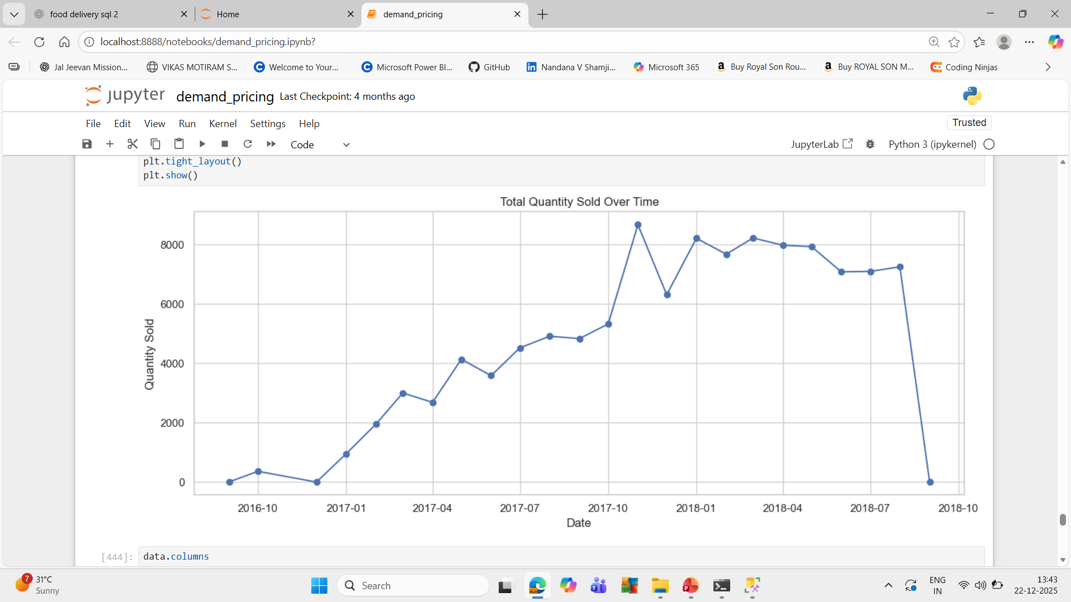
Python: Pricing Model & Analysis
Role of Python
Cleaned and prepared raw datasets
Outcome
Explored price distribution and demand behavior
The optimal price derived from Python is used as a pricing KPI in the dashboard.
Engineered features (delivery duration, time variables, price buckets)
Built a pricing model to analyze price–demand relationship
Estimated an optimal price point

Slide 5
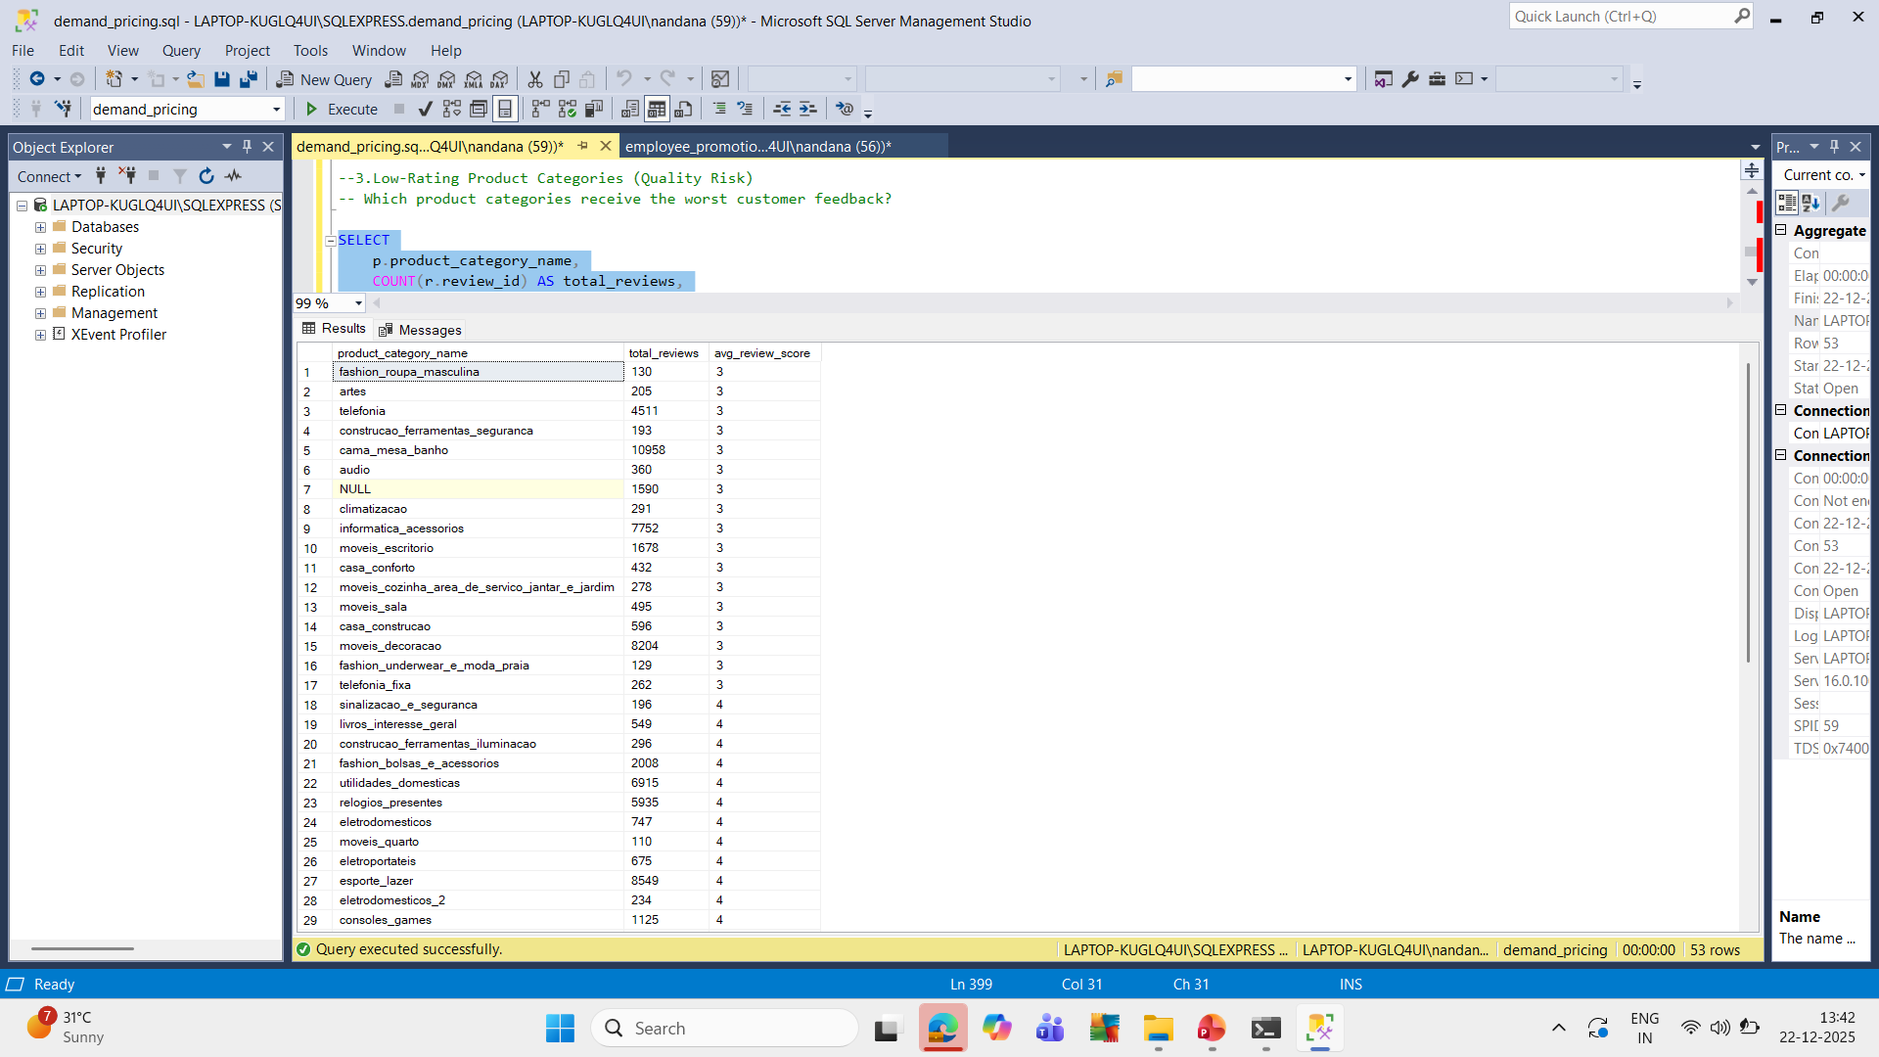

SQL: Schema & Data Engineering
What was done in SQL
Why it matters
Designed a normalized schema (6 core tables)
Ensures data integrity
Enables reliable and repeatable business analysis
Enforced primary and foreign keys
Used staging tables for data imports
Handled real-world data issues (duplicate reviews)

Slide 6
SQL: Key Business Insights
Key findings from SQL analysis:
Seller Risk
Delivery Delays
Cancellation risk is concentrated among low-volume sellers
Carrier delays exceed seller delays
Revenue Concentration
Customer Behavior
Revenue is highly concentrated among a small group of sellers
The average customer places only one order
These insights highlight operational and platform risks.

Slide 7
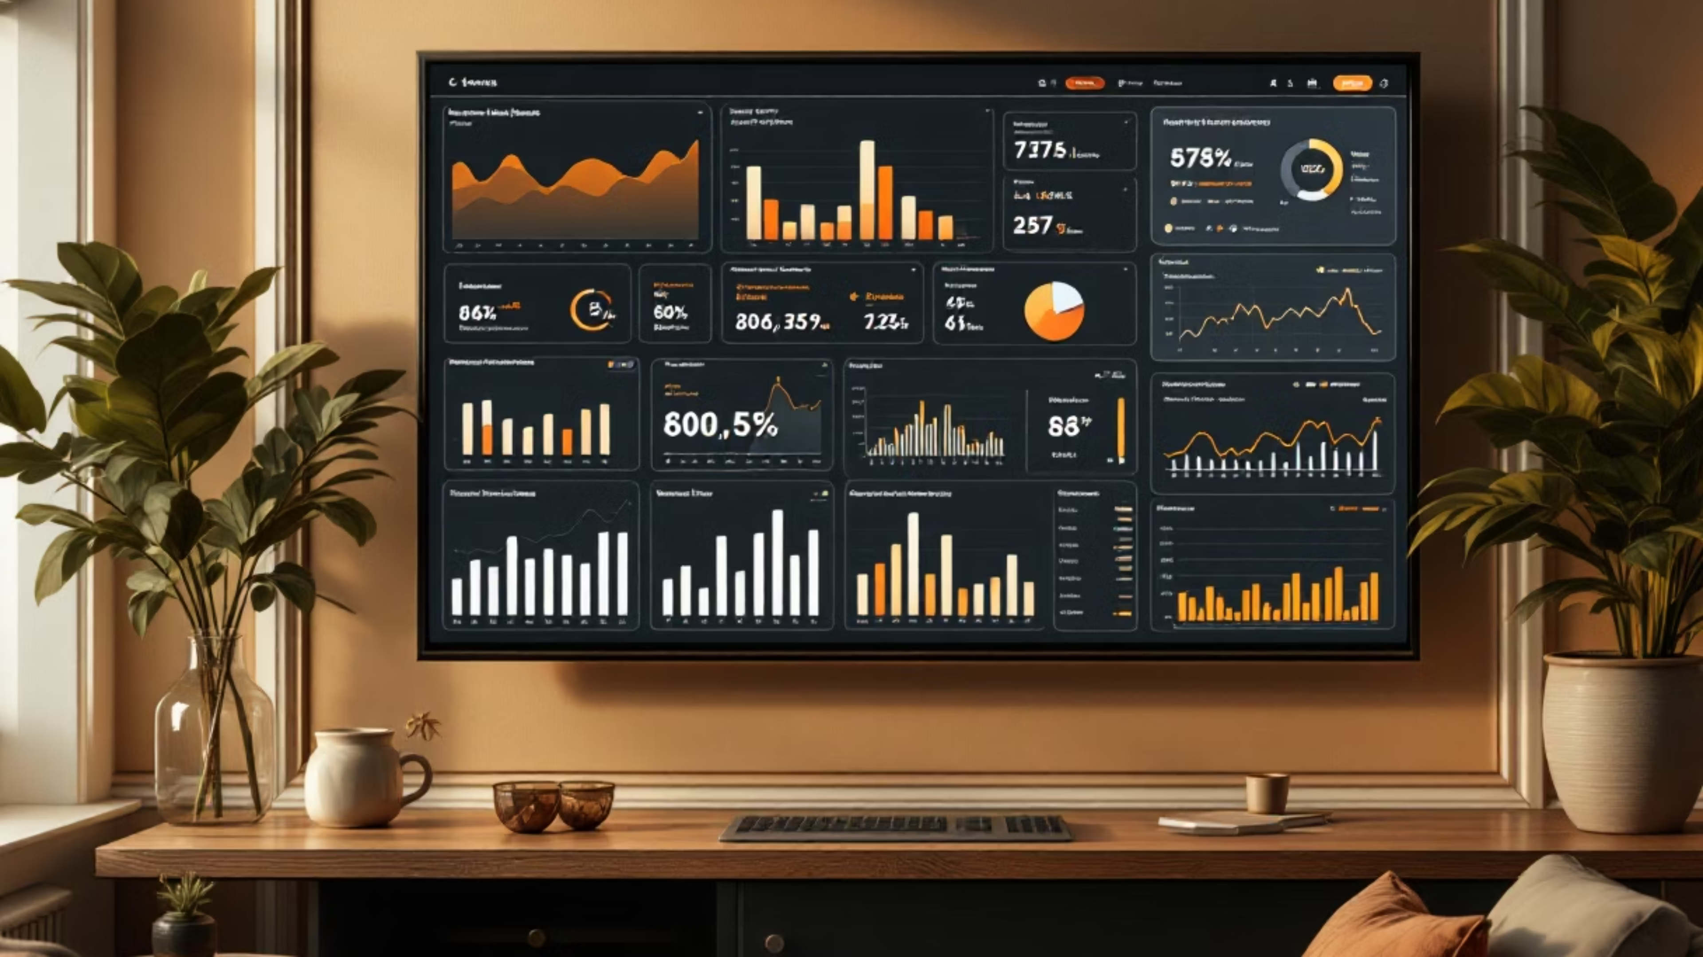
Dashboard: KPIs
Key Metrics Displayed
98,666
₹13.59M
₹137.75
₹93
Total Orders
Total Revenue
Average Order Value (AOV)
Optimal Price
(derived from Python pricing model)
Dashboard Purpose: Provide a quick, executive-level overview of pricing and operations.

Slide 8
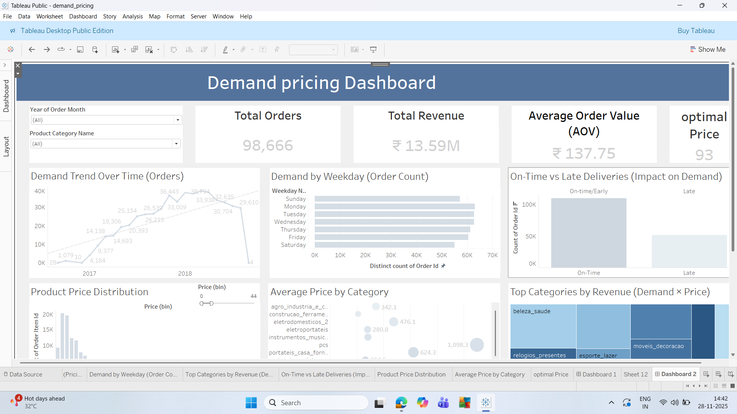

Slide 9
Dashboard: Visual Insights
Demand Trend
Demand shows a clear upward trend over time
Weekly Patterns
Orders are higher on weekdays than weekends
Delivery Performance
Majority of orders are delivered on time
Product Catalog
Product catalog is skewed toward low-priced items
Revenue Drivers
Revenue is driven by a few key categories

Slide 10
Business Implications
01
02
Logistics Optimization
Seller Monitoring
Improve logistics partner performance to reduce delivery delays
Monitor and manage high-risk sellers early
03
04
Revenue Diversification
Retention Strategy
Reduce dependency on top sellers by scaling mid-tier sellers
Pricing optimization alone will not improve customer retention
Data points to areas where operational focus is required.

Slide 11
Conclusion & Skills
Conclusion
Skills Demonstrated
Built a Python pricing model to estimate an optimal price
Python: data cleaning, feature engineering, pricing model
Used SQL to validate operational patterns and business risks
Communicated insights through an executive dashboard
SQL: joins, CTEs, CASE logic, window functions
Business analytics & insight communication
This project demonstrates how modeling, relational analysis, and visualization work together to support data-driven decisions.

